Slide 1

National Cancer Imaging Archive (NCIA)
https://imaging.nci.nih.gov
April 12, 2007

Slide 2
Summary
Overview
Functionality
Architecture and API
Object Model

Slide 3
Overview

Slide 4
What is NCIA?
National Cancer Imaging Archive
Searchable repository of in vivo cancer images in DICOM format
Publicly available at no cost over the Internet
Open source (Java J2EE based)
In addition to images, NCIA contains:
  Non-image files (PDF, image markup)
  Annotation data provided by a curator
Notes:
Developed by National Cancer Institute Center for Bioinformatics (NCICB) and the Cancer Imaging Program (CIP)
Compatible with Cancer Biomedical Informatics Grid (caBIG)
Examples of non-image files are PDFs (radiologist reports, pathology reports, optical videos), and image markup

Slide 5
Goals of NCIA
Provide a resource for sharing image sets and related information
Encourage collaboration during clinical trials involving imaging
Support research and development of imaging biomarkers
Provide images as an educational resource
Support computer aided detection (CAD) algorithm development
Use image sharing to facilitate partnerships between organizations (Cooperative Groups)
Notes:
Break down barriers that prevent sharing of images between organizations
NCIA assists CAD developers by providing images to assist in the creation and validation of the algorithms
Partnership organizations: ACRIN, COG, QARC, ATC, NIST, NIBIB
Reduce or eliminate cost of obtaining quality image sets for educational or algorithm development purposes

Slide 6
Functionality

Slide 7
Image Submission
Medical Imaging Resource Center (MIRC)
MIRC addresses two barriers to image sharing across the Internet
  DICOM protocol typically blocked at firewalls
  Protected Health Information (PHI) in DICOM header
Images submitted via HTTPS
PHI removed during configurable anonymization process at submitting site
Notes:
MIRC developed by RSNA
Images are checked for quality and PHI by NCI prior to being made available to the public

Slide 8
Image Repository
Web based thin client access to more than 1.7 million DICOM images plus Annotation files and curation data
Search for cases/images based on criteria such as Image Modality, Slice Thickness, Collection, etc…
Search for cases/images based on curation data
Download of search results using an intuitive “shopping cart” feature
Downloads now include curation data if available
Visualize images in the repository using the integrated Cedara I-Response Workstation on your PC
Federated searches and image downloads
Coming Soon:
  “Virtual Central Reads” from the image repository using I-Response
  Image markup persistence and ability to search on markup data such as tumor size reduction

Slide 9
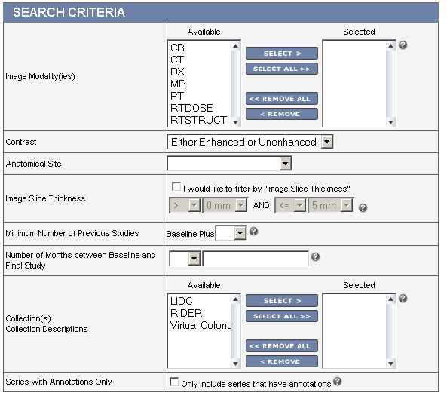
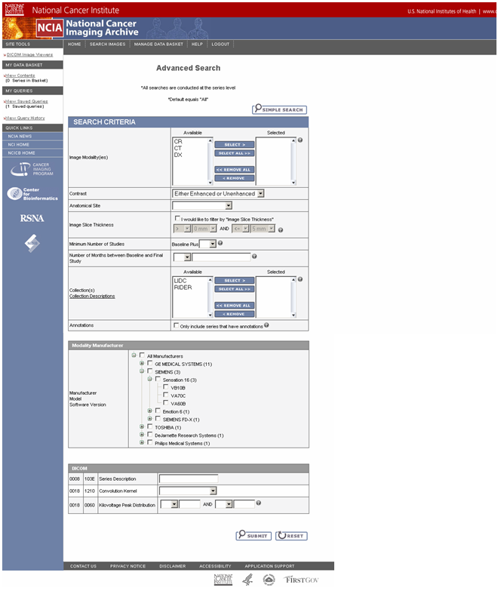
Search for Images
Notes:
Search fields:
Modality
Presence of Contrast Agent
Anatomical Site
Slice Thickness
Minimum Number of Previous Studies
Number of Months between Baseline and Final Study
Collections
Presence of Annotations

Slide 10
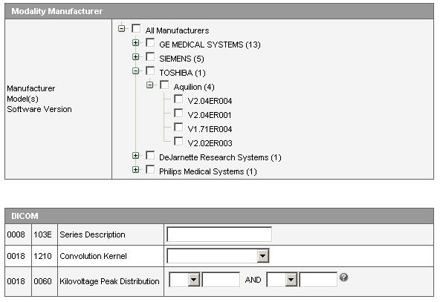
Search for Images
Notes:
Search fields:
Manufacturer / Model / Software Version
Series Description
Convolution Kernel
KVP

Slide 11
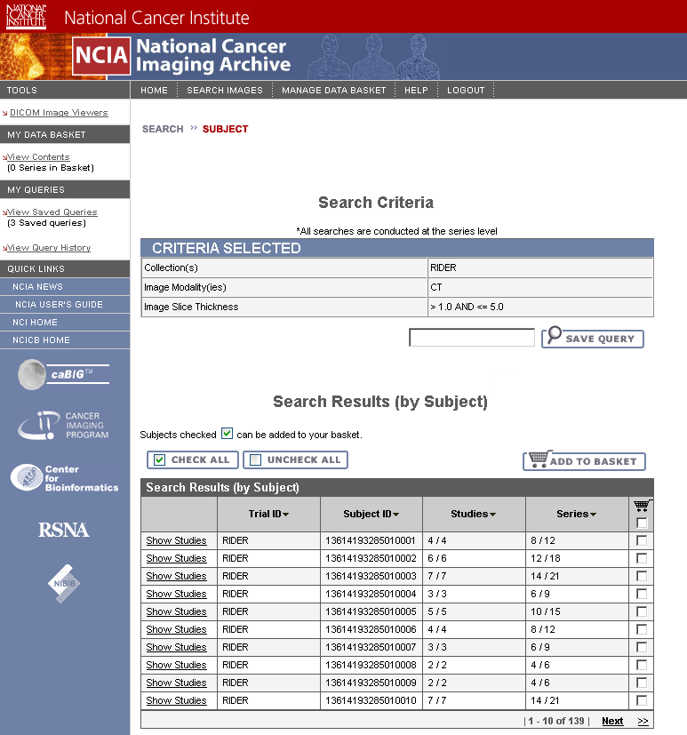
Search Results – Patient List
Notes:
Search results are initially presented as list of patients
Data is added to data basket for download

Slide 12
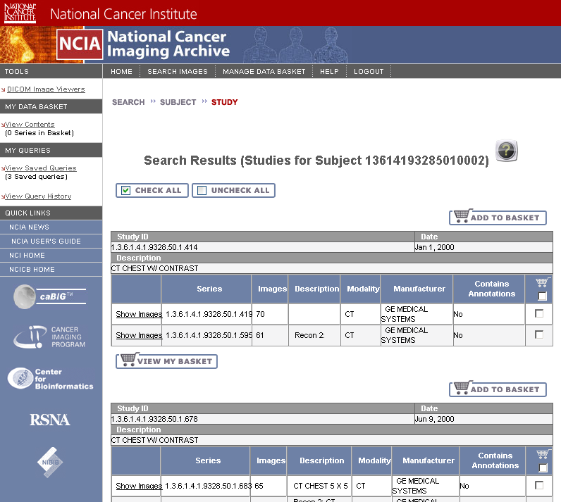
Search Results – Studies for Patient
Notes:
Users can drill down to view studies for each patient

Slide 13
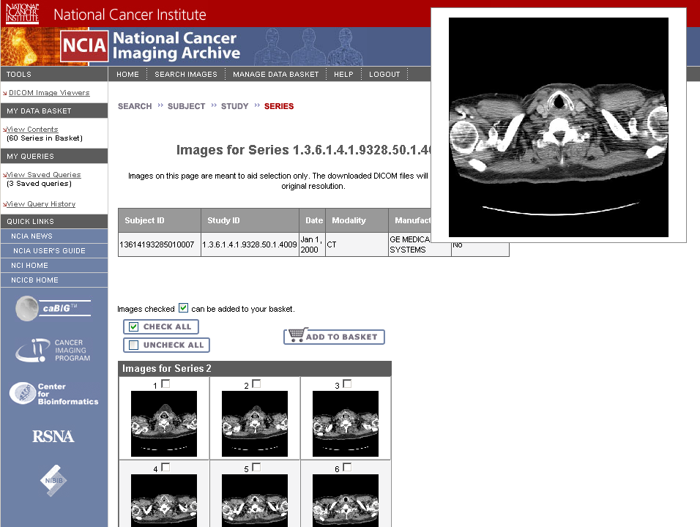
Search Results
Notes:
View image thumbnails (JPEG) for each series
Add individual images to data basket for download

Slide 14
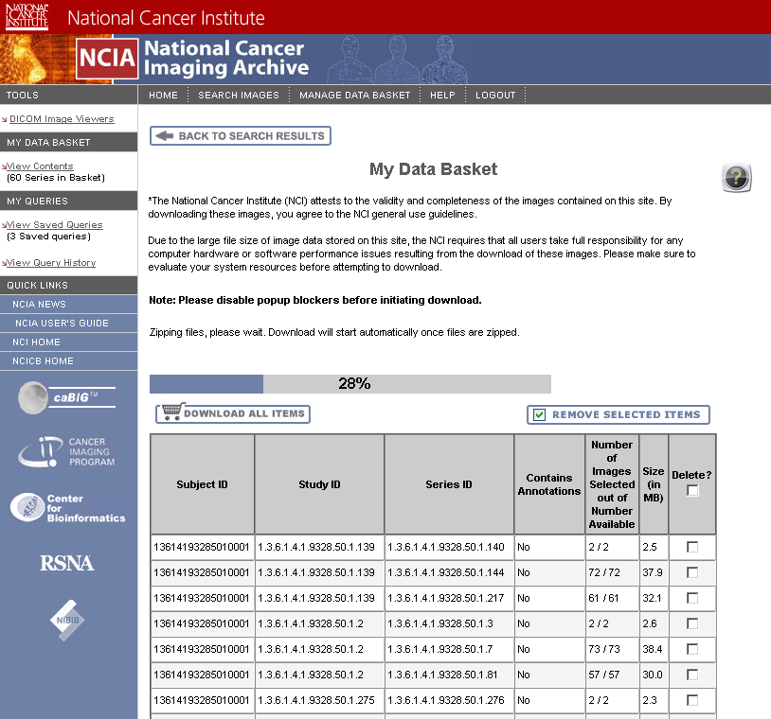
Download Images
Notes:
Downloaded as zip file with directories for patient, study, series
Small (<3GB) result sets are downloaded in the browser while the user waits
Larger downloads (>GB) are done via FTP. User receives an email when ready

Slide 15
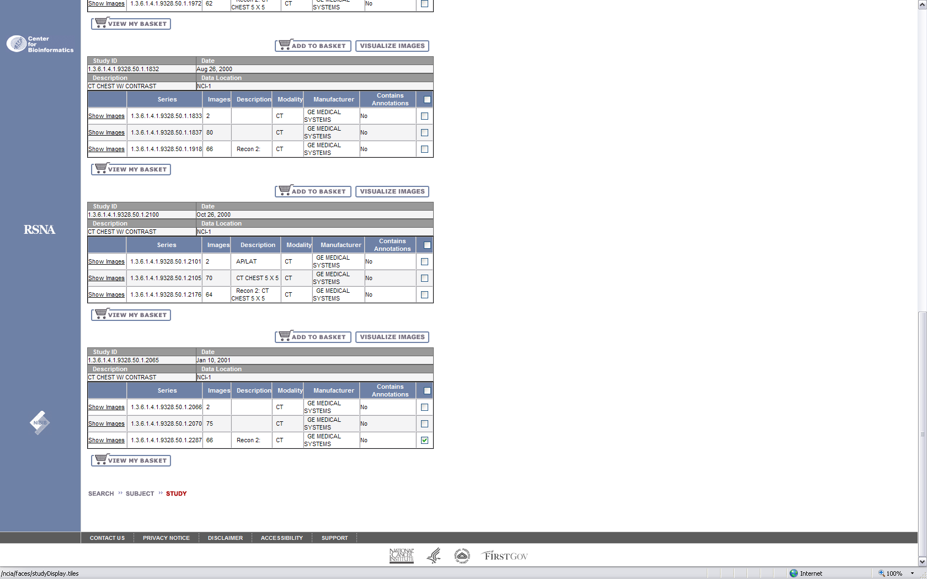
Image Visualization

Slide 16
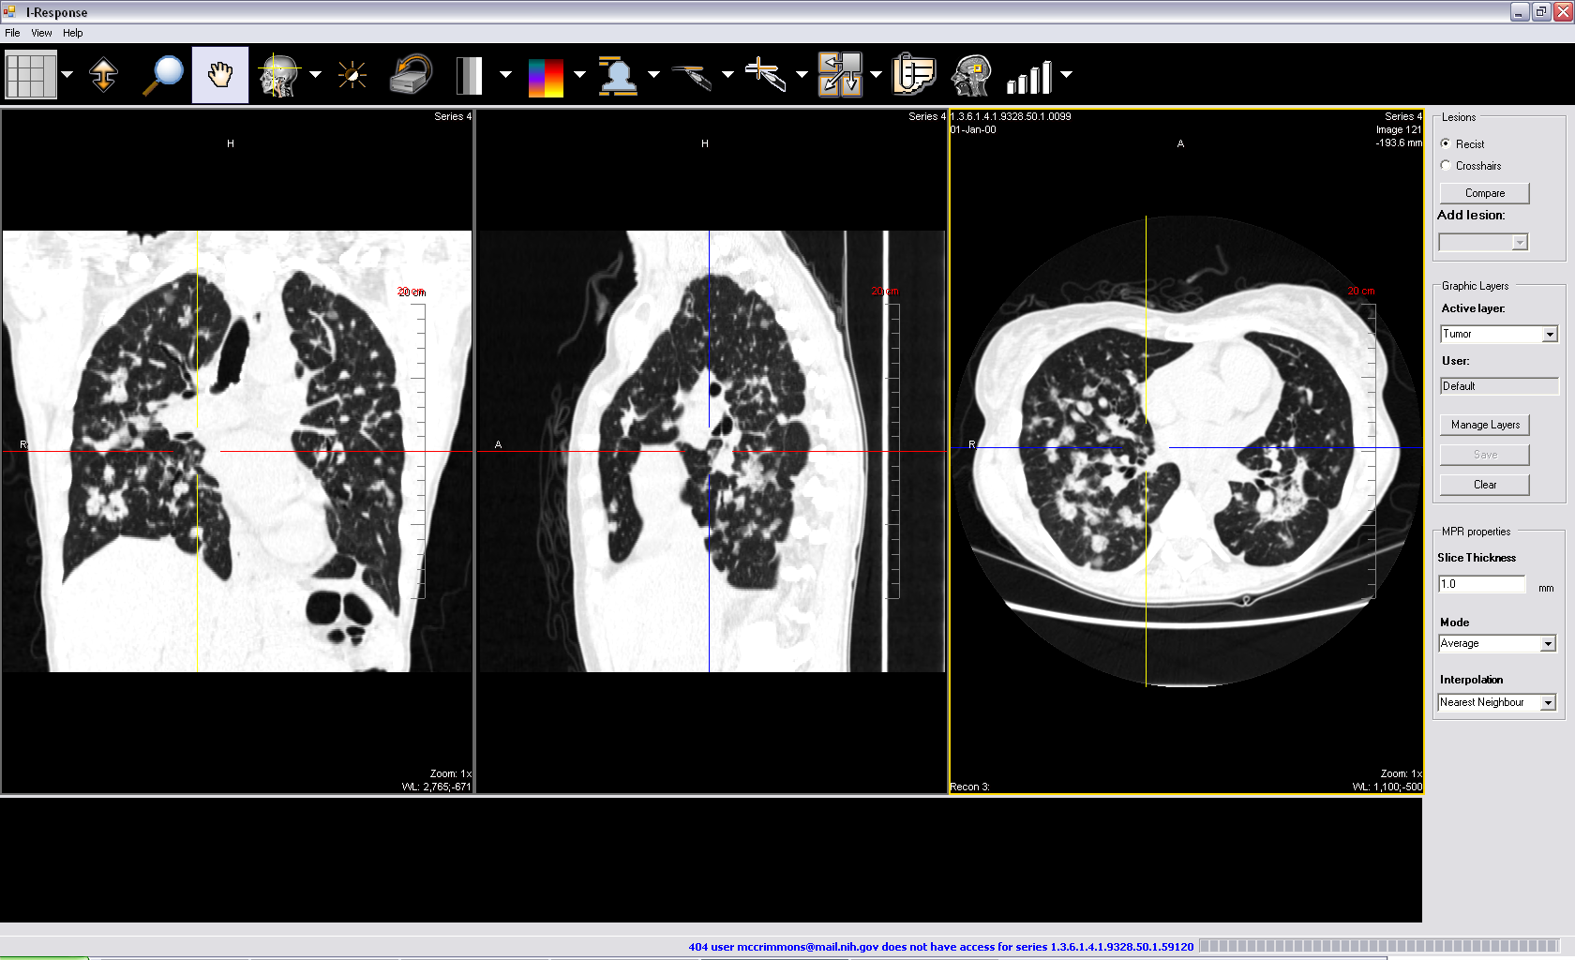
I-Response Workstation integration

Slide 17
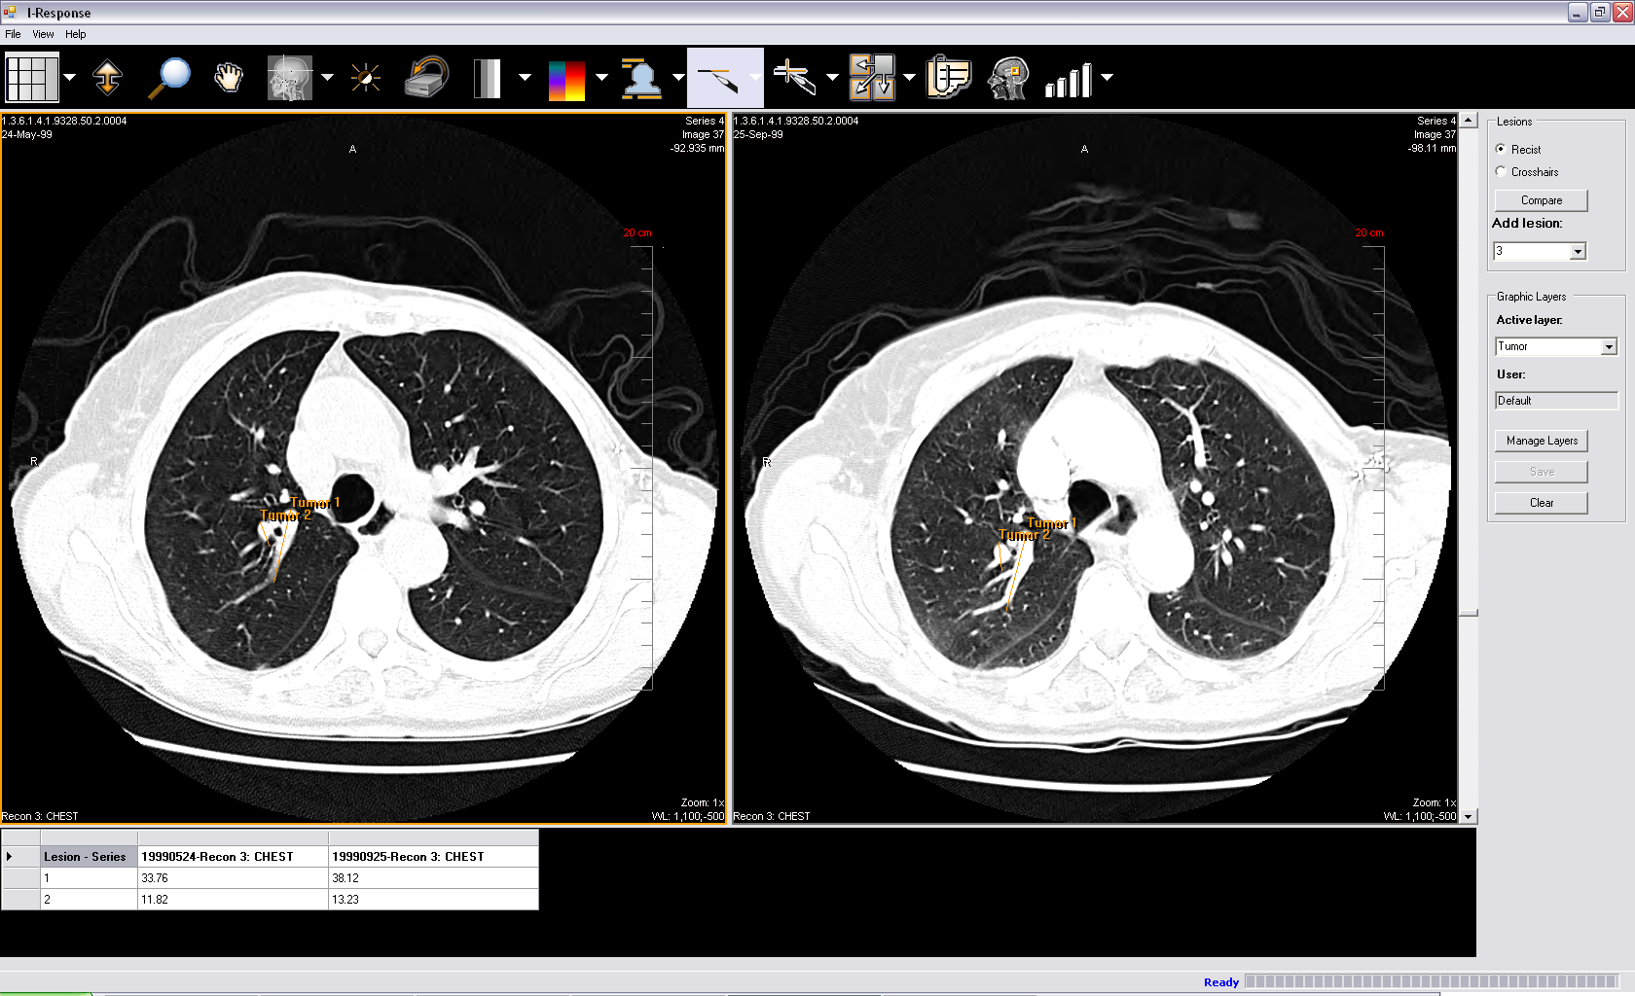
I-Response Workstation integration

Slide 18
Architecture and API

Slide 19


Image Submission and Federated Search
Data Transfer
Object (DTO)
Java Server
Faces (JSF)
Retrieval
Field Centers
at Remote
Clinical Sites
HTTP
FTP
Processors
Query, Result set, User Registration, Lookup Manager, CSM, Export
Cancer Centers /
Academia /
Industry
MDB
Image zipping
Data
Access
Layer
Grid Client
Data Manager
Data Manager
Submission
NCIA caCORE API
CSM API
MIRC
Field
Center
De-ID
Tomcat
Firewall
DICOMHTTP
HTTPS
NCIA
Grid Services
MIRC
Hibernate
Hibernate
Hibernate
MIRC
Field
Center
MIRC Storage Service
De-ID
caGRID
Nodes
Firewall
Generic
Grid Services
Firewall
MIRC DICOM Service
Database
Researchers
MIRC
Field
Center
MIRC Database Service
De-ID
Firewall

Slide 20
IRW Integration
PC
NCICB
IRW
Cedara Server
Browser
NCIA

Slide 21
NCIA APIs
caCORE
  caCORE API generated from caCORE SDK Toolkit
  Domain objects available through caCORE queries
  Domain classes registered in caDSR
caGRID Data Service
  Exposes NCIA caCORE API over caGRID
  Generated using caGRID tools
  Query via Common Query Language (CQL)
  Domain objects returned

Slide 22
NCIA APIs cont.
NCIA Grid Data Service
  Exposes NCIA DTO’s to caGRID
  Implemented to enhance performance between NCIA caGRID Nodes
Both NICA Grid Services use security filters based on CSM to prevent the retrieval of non public data
  The decision not to implement security with the caGRID security framework was based on the need for validation across multiple objects, and to simultaneously consider multiple security attributes within an object.

Slide 23
Object Model

Slide 24
Object Model
Object model based on DICOM standard
DICOM is standard for digital imaging
Basic Hierarchy
  TrialDataProvenance – site that collected images for a collection
  Patient – Person being imaged
  Study – Grouping of one or more Series taken at one visit
  Series – Grouping of images
  Image – A digital in vivo image
  Annotation – A non-image file associated with a series

Slide 25
Object Model
Model consists of DICOM classes as shown on previous slide and “DTOs”
  DTOs are usually tied to database views and are used to retrieve information in a performance-enhanced way
  DTOs were not included in submitted model

Slide 26
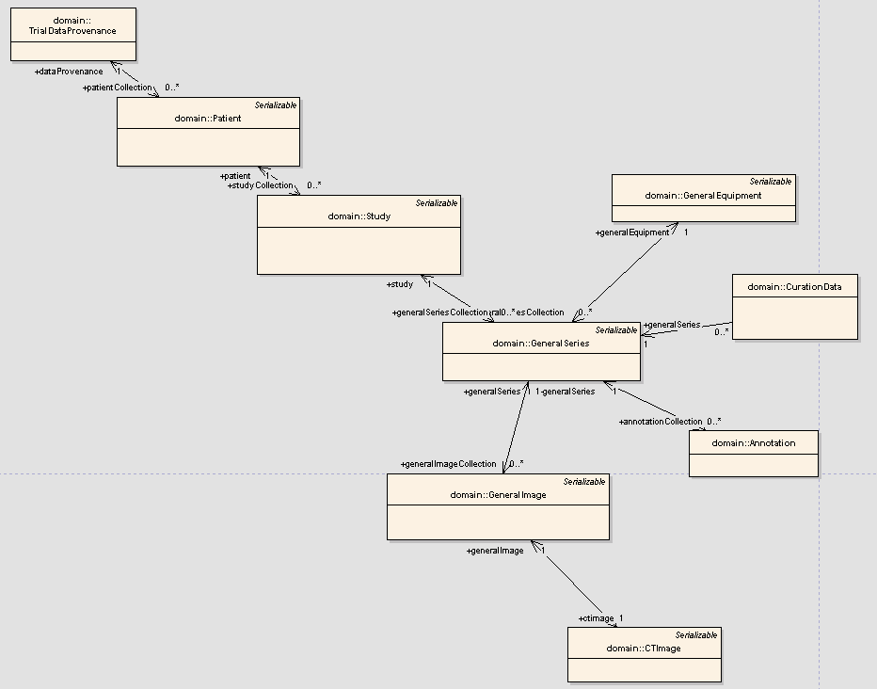

Slide 27
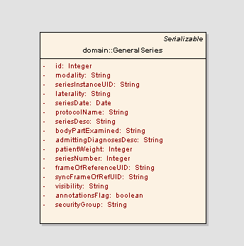
Example: GeneralSeries class

Slide 28
Questions

